Slide 1
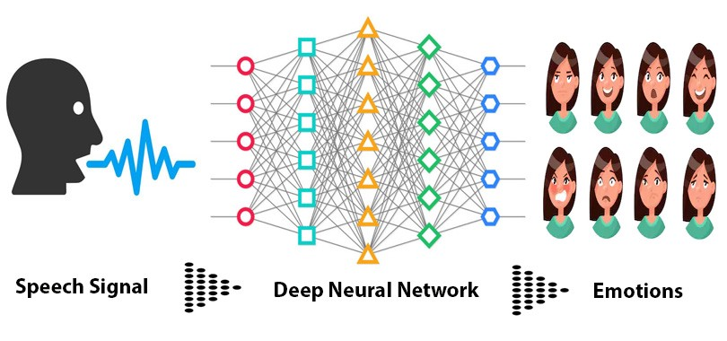
Speech Emotion Recognition(SER)
Presented By
M.Sirisha (N150535)
M.Padmini (N151158)
P.Sravani (N150207)
B.Yellareswari (N150055)

Slide 2
Abstract
Speech Emotion Recognition, abbreviated as SER, is the act of attempting to recognize human emotion and from speech. This is capitalizing on the fact that voice often reflects underlying emotion through tone and pitch.The emotions considered for the experiments include neutral,calm,happy,fearful,disgust,surprised.

Slide 3
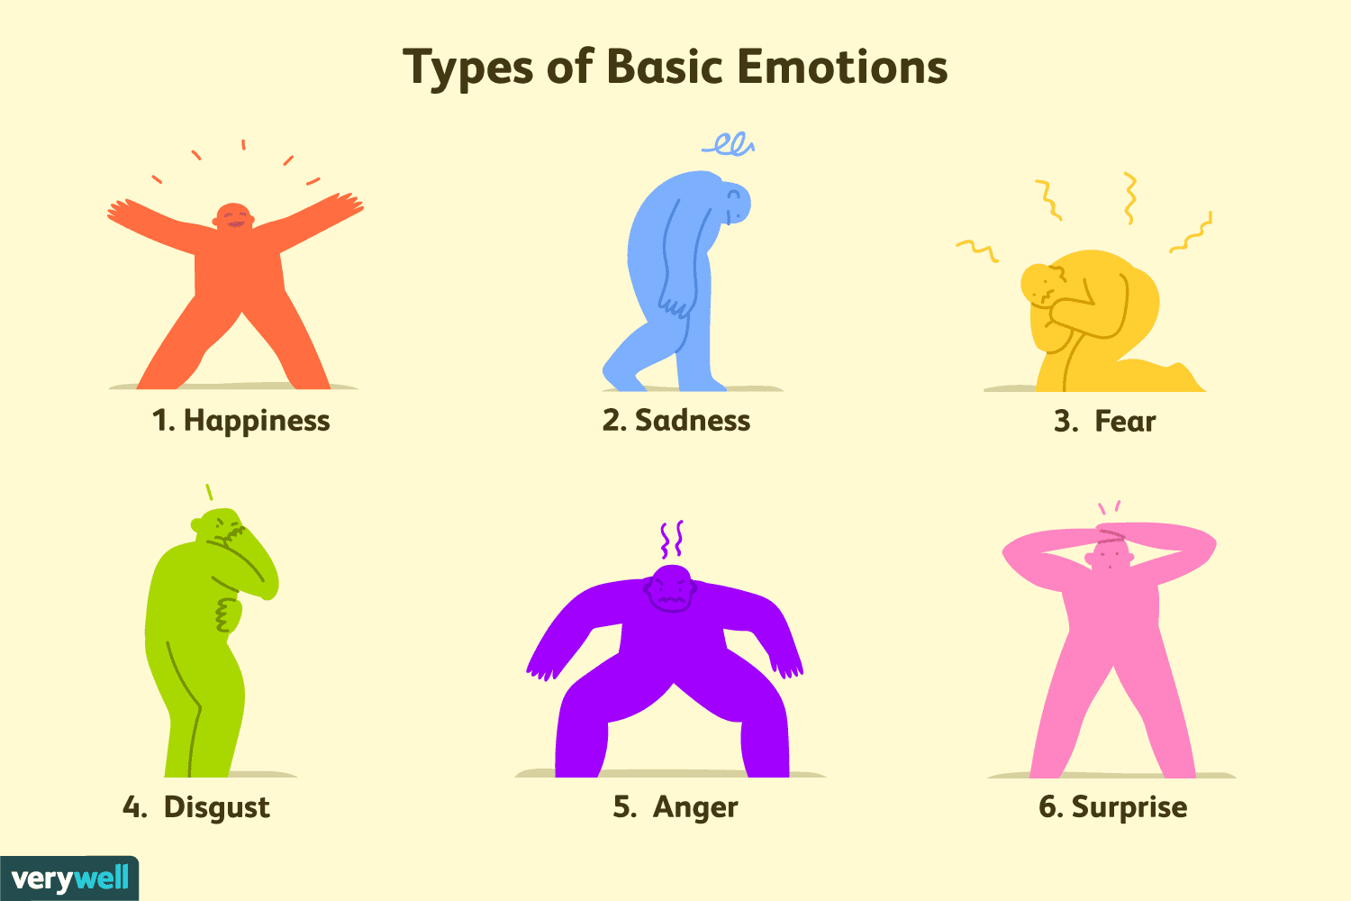
The problems
Present systems doesn't give accurate results.
To give better services

Slide 4

Best possible solutions
Using Speech
Use Gestures
Use Body pose

Slide 5

Problem with Facial expressions :
Requires high pixel camera
More lighting
Waiting time is high

Slide 6
Problem with Images :
It may take more space
Require clear image
Doesn't work for group Images

Slide 7
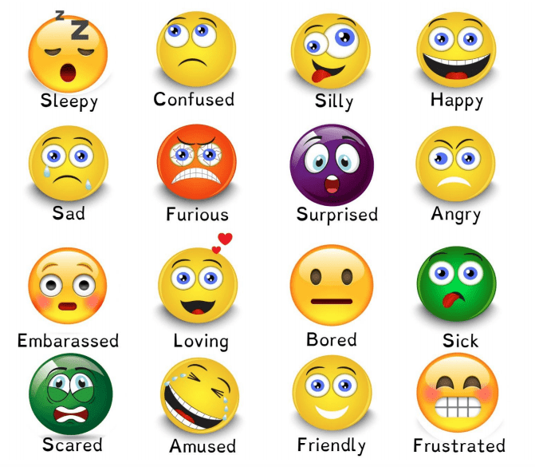
Using Speech Emotion Detection
Using Speech Emotion Detection

Slide 8
Disadvantages :
Doesn't work for noise data
Less accuracy for the data from group of people

Slide 9
Advantages :
Less time complexity
Used for customer care and many.
Easily implemented

Slide 10
How it works
Step 3
Step 2
Step 1
Detect the emotion
Feature extraction and MLP classifier
Create and train the dataset

Slide 11
Modules :
Two of the major components of an emotional speech recognition system
Feature Extraction
Emotion Classification

Slide 12
Feature Extraction :
Features represent the characteristics of a human vocal tract.
MFCC : Mel Frequency Cepstral Coefficient , derived from a type of cepstral representation of the audio clip. Used in systems which can automatically recognize the sppech.
Chroma : It belongs to the 12 different pitch classes.It is a descript which represents the tonal content of a musical audio.
Mel : Mel Spectrogram Frequency. Used to plot the spectrogram of a speech.

Slide 13
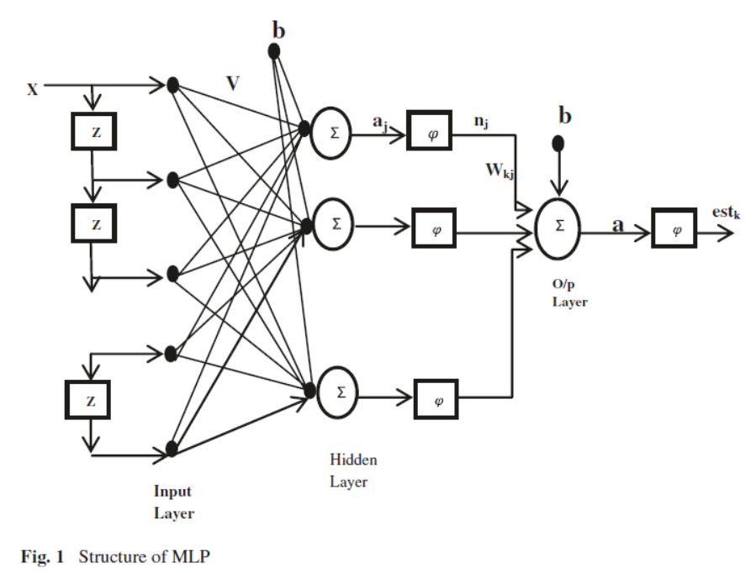
Emotion Classification :
It is a network of connected neurons which
works together to solve complex (non-linear)
problems.
Its inspiration was taken from the human brain where multiple neurons are connected.
MLP Classifier is used to compare the different extracted features to give the result.

Slide 14
Technologies used :
Dataset from online sources
MLP classifier
Packages like os,glob,pickle etc
Implemented on jupyter lab

Slide 15
Technical specification :
Clear audio without noise
jupyter lab
And just a computer...

Slide 16

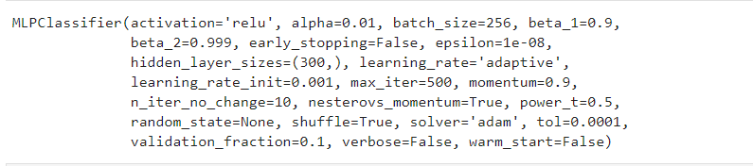
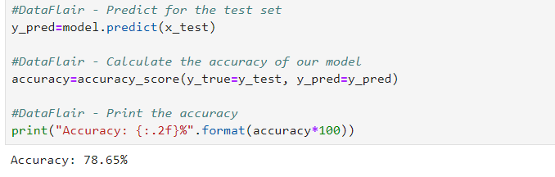
Output Screens:
(Training , Testing)
Extracted Features
MLP Classifier and its parameters
Overall Accuracy

Slide 17
Future Improvement :
Songs given based on emotion
Tells emotion through speech
Working for noise data

Slide 18
Conclusion :
The idea of detecting the emotional state of a person by speech processing techniques. The study on words and letters under different emotional situations proved that the emotional state can alter the speech. It was observed that there are distinguishable features in a speech segment that characterizes each emotion state. After performing the classification tests on a dataset , it was observed that it is better considering data from an individual subject rather than a group of people.

Slide 19

References :
http://www.ldc.upenn.edu/Catalog/CatalogEntry.jsp?catalogId=LDC2002S28
http:// D.Talkin, “A Robust Algorithm for Pitch Tracking (RAPT)”, Speech Coding & Synthesis,1995
T.Bänziger, K.R.Scherer, “The role of intonation in emotional expression”, Speech Communication, Vol.46, 252-267, 2005
https://data-flair.training/blogs/python-mini-project-speech-emotion-recognition.

Slide 20


